Slide 1
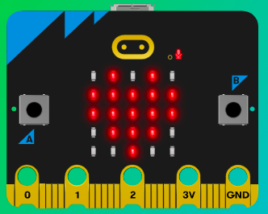
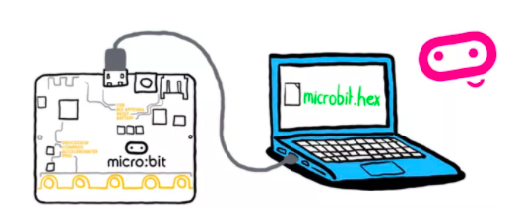
MicroMakers!
KIDS’ MAKER CLUB OF WASHINGTON, DC
Meet Up #15

Slide 2
RECAP!
Notes:
LEDs, Buttons, Light Sensor

Slide 3
RECAP!
Radio! What is radio for?
What is a Transmitter and what is a Receiver?
What is a Transceiver?
What programming languages do you know?
Micro:bit Inputs and Outputs
Scratch Inputs and Outputs
Compass Degrees
X-Y Coordinate Plane
If, Then, Else
Variable
Loops
Sprite
Bells and Whistles

Slide 4
CIRCUITS!

Slide 5
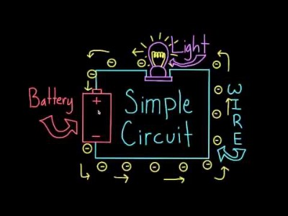
What is a Circuit?

Slide 6
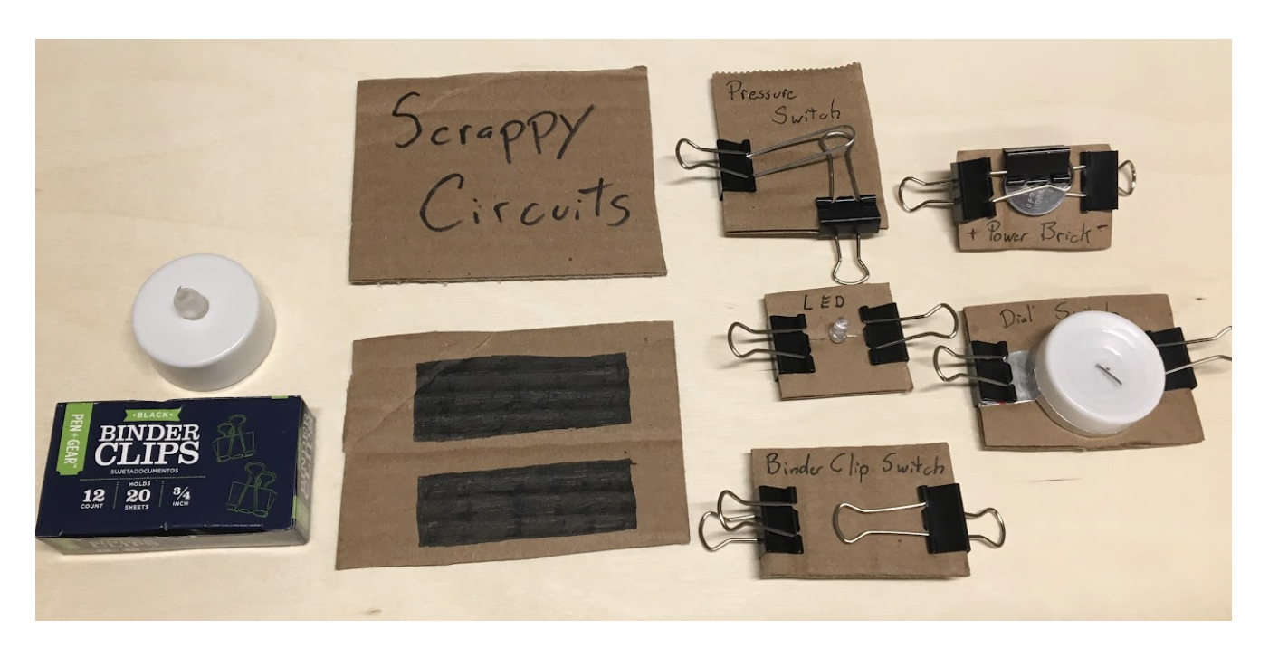
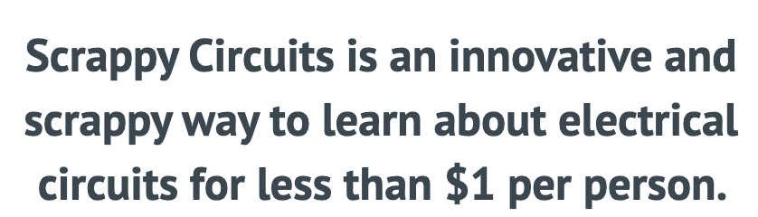
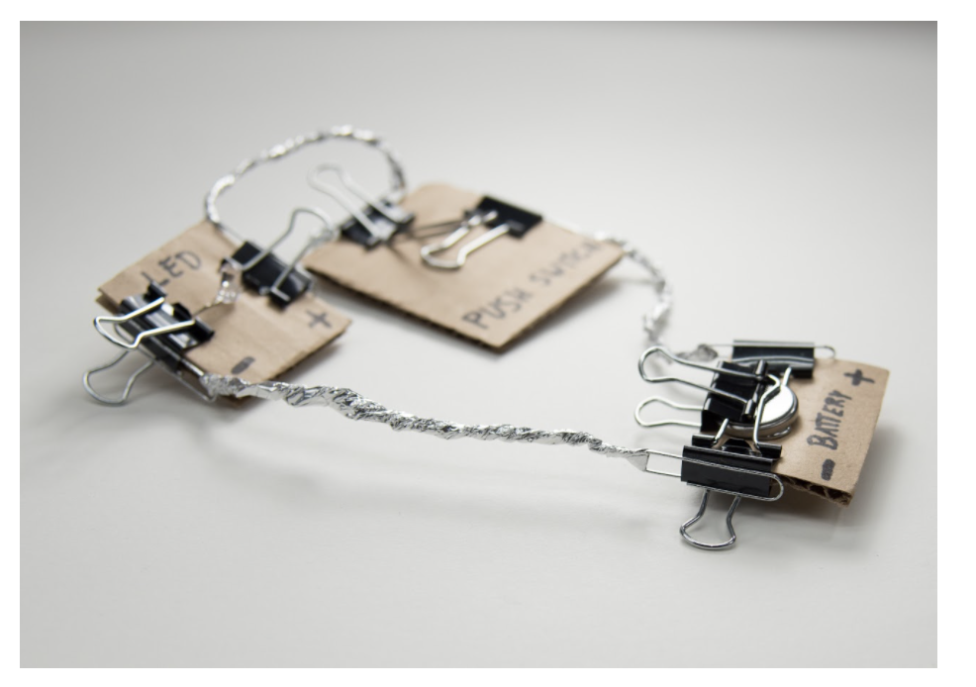
What are Scrappy Circuits?
(aside from very cool)

Slide 7
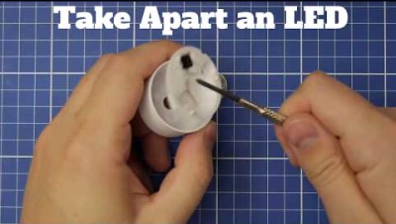
What are Scrappy Circuits?

Slide 8

Scrappy Circuit Project: Morse Code
Oh boy, here we go!

Slide 9
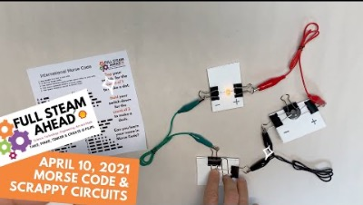
Step 1: The Project Morse Code Transmitter
What is it?
Before telephones and telegraphs, people sent long messages to each other using Morse code. We’ll create our own Morse code devices today!
What do I need?
Working tea light
Small screwdriver
7 binder clips
Paper clip
3 alligator wire clips
Cardboard
Marker

Slide 10
Step 2: How Does it Work?
We will create three circuit blocks:
Batter block
Light block
Switch
Using the switch, we can adjust the current flowing through our circuit, turning the light off and on, using Morse code patterns.

Slide 11
Step 3: Make It!
Take apart tea light to retrieve LED and battery
Tidy up!
Make battery block
Test LED on battery and identify positive side
Make light block
Test with alligator wire clips connecting two blocks
Make simple switch (two binder clips)
Test with alligator wire clips connecting three blocks
Make morse code switch (+ paper clip)
Send test message!

Slide 12
Step 4: Share Your Creation!

Slide 13
BREAK
Hop on one foot 20 times!

Slide 14
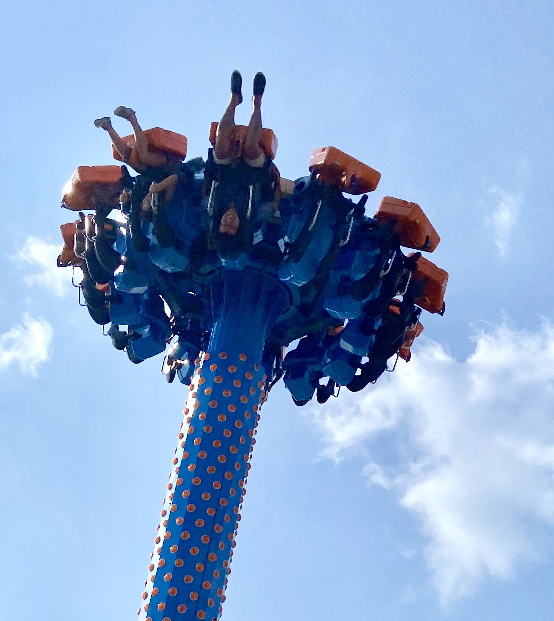
SKILL BADGE
Scrappy Circuits
YOUR MISSION
Make a circuit with an LED and two switches!

Slide 15
TIME TO PUT AWAY OUR SCRAPPY CIRCUITS!
Neat and tidy, please!
Let’s leave this beautiful room as lovely as we found it!

Slide 16
NEXT TIME
Sound!!

Slide 17
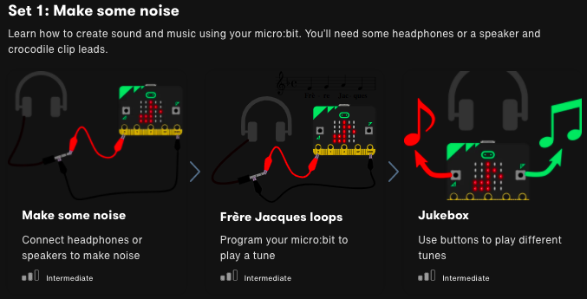

Slide 18
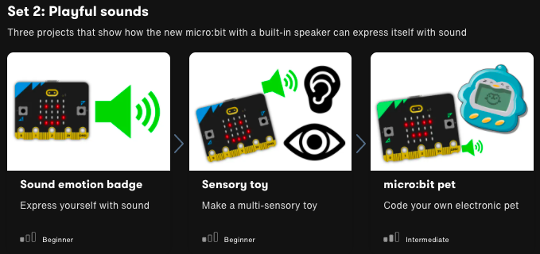

Slide 19
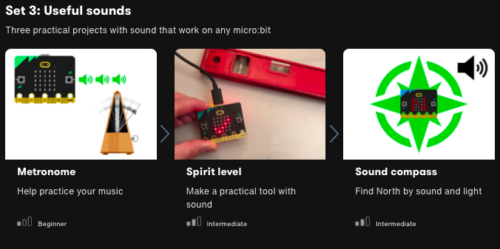

Slide 20

UNTIL NEXT TIME….
MicroMakers!
Slides and Script: Holly Krambeck (learningpython64@gmail.com)
Project Videos, Images, and Text: https://microbit.org/get-started

Slide 21
EXTRA SLIDES

Slide 22
PROGRAMMING PRACTICE!
Expanding Robot Turtles with Loops, Conditions, and Variables

Slide 23
Coding Building Blocks
Practicing Variables, Loops, and Conditions…with Robot Turtles
Variables
Conditions
Loops

Slide 24
Deep Dive into the Code
Practicing Variables, Loops, and Conditions…with Robot Turtles
Variables
Convert “Forward” to a variable, “Forward = X spaces”. Roll the die on each turn to assign random value to “Forward”
Conditions
If Forward <= 3 spaces, add 1 card (any) to your turn. Else, do nothing.
Loops
While no gem is reached, continue playing the game.

Slide 25
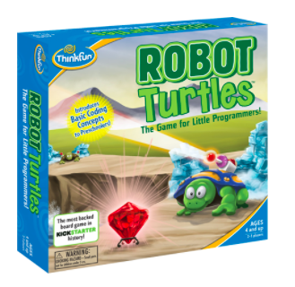
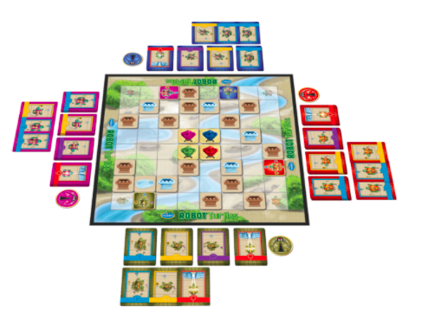
Programming
Let’s Try It!
You tell computers like the micro:bit what to do by giving them instructions. Sets of instructions for computers are called programs. Programs are written in code, a language that both you and the computer can understand.

